Slide 1
Bhuruz oop-project

Slide 2
Hello!
We are Team Bhuruz
You can find us at
St.habib.edu.pk@ak06857 – Ali Asghar Kerai
St.habib.edu.pk@ak06865 – Areeb Adnan Khan
St.habib.edu.pk@lm06435 – Lakshman Maheshwari
St.habib.edu.pk@mm06886 – Muhammad Jazzel Mehmood

Slide 3
1.Updated Assets
Background, Objects and Maps

Slide 4

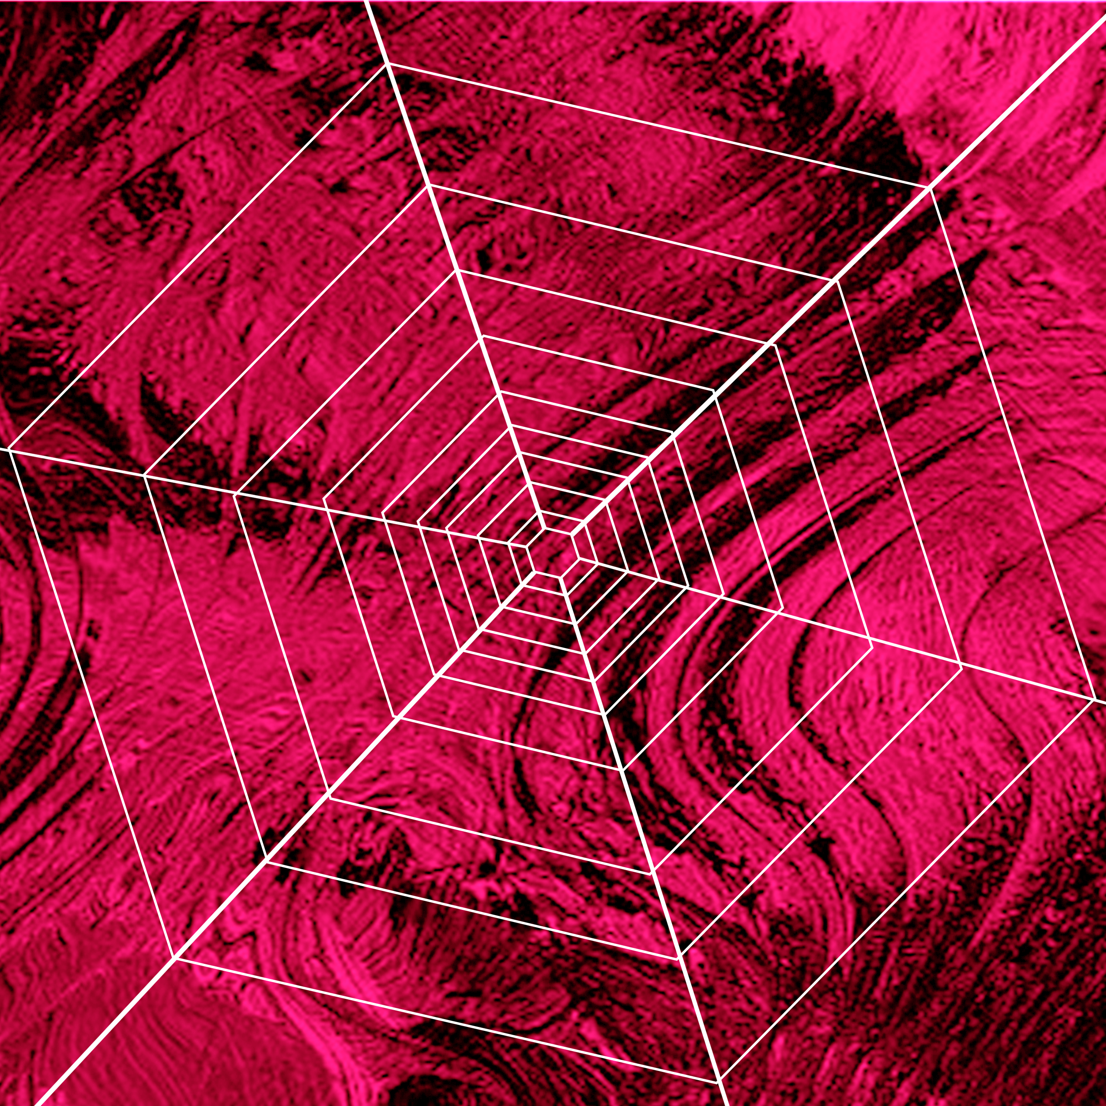
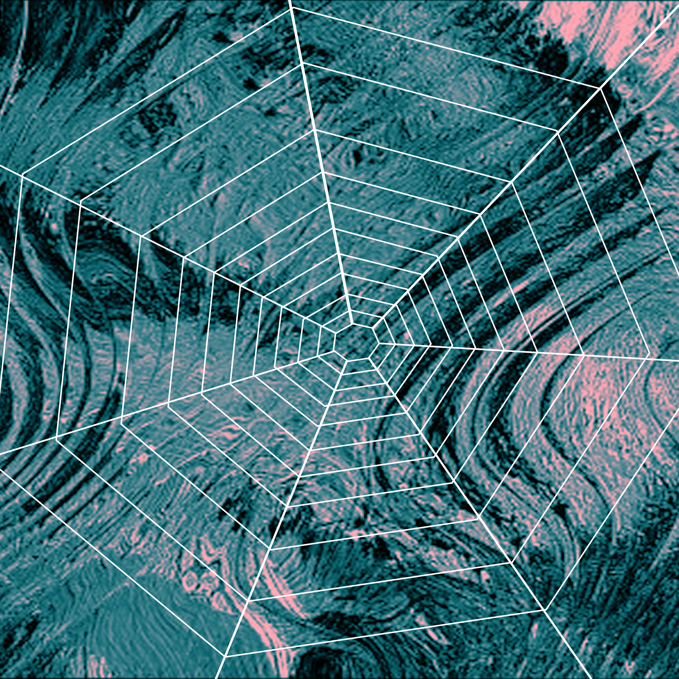
Easy
Medium
Hard

Slide 5
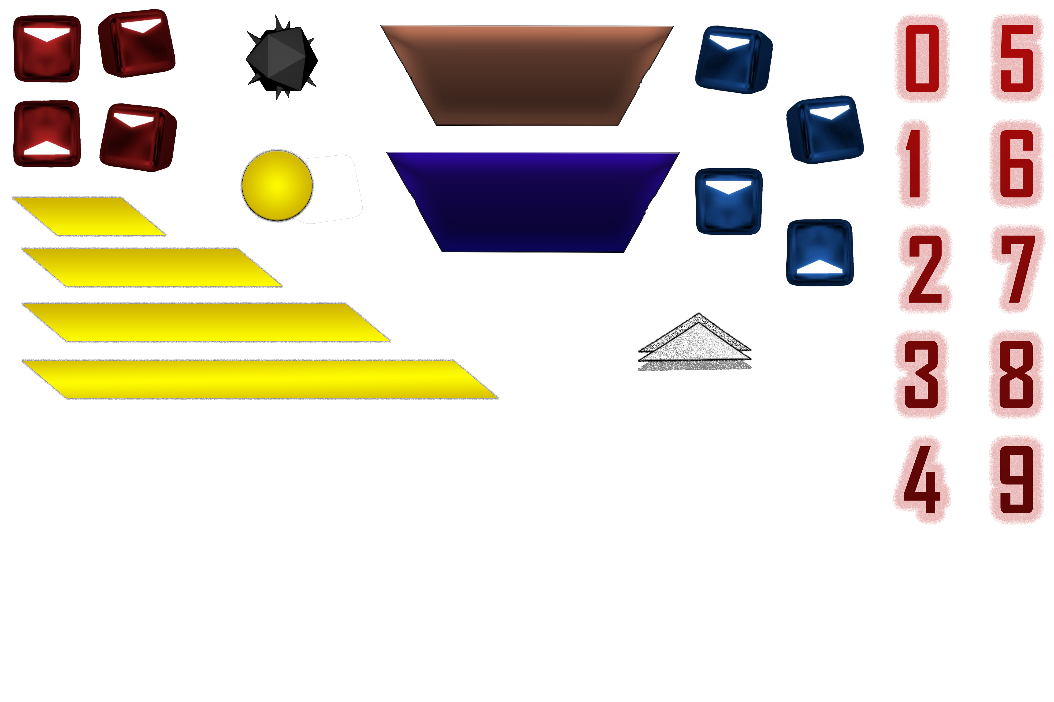
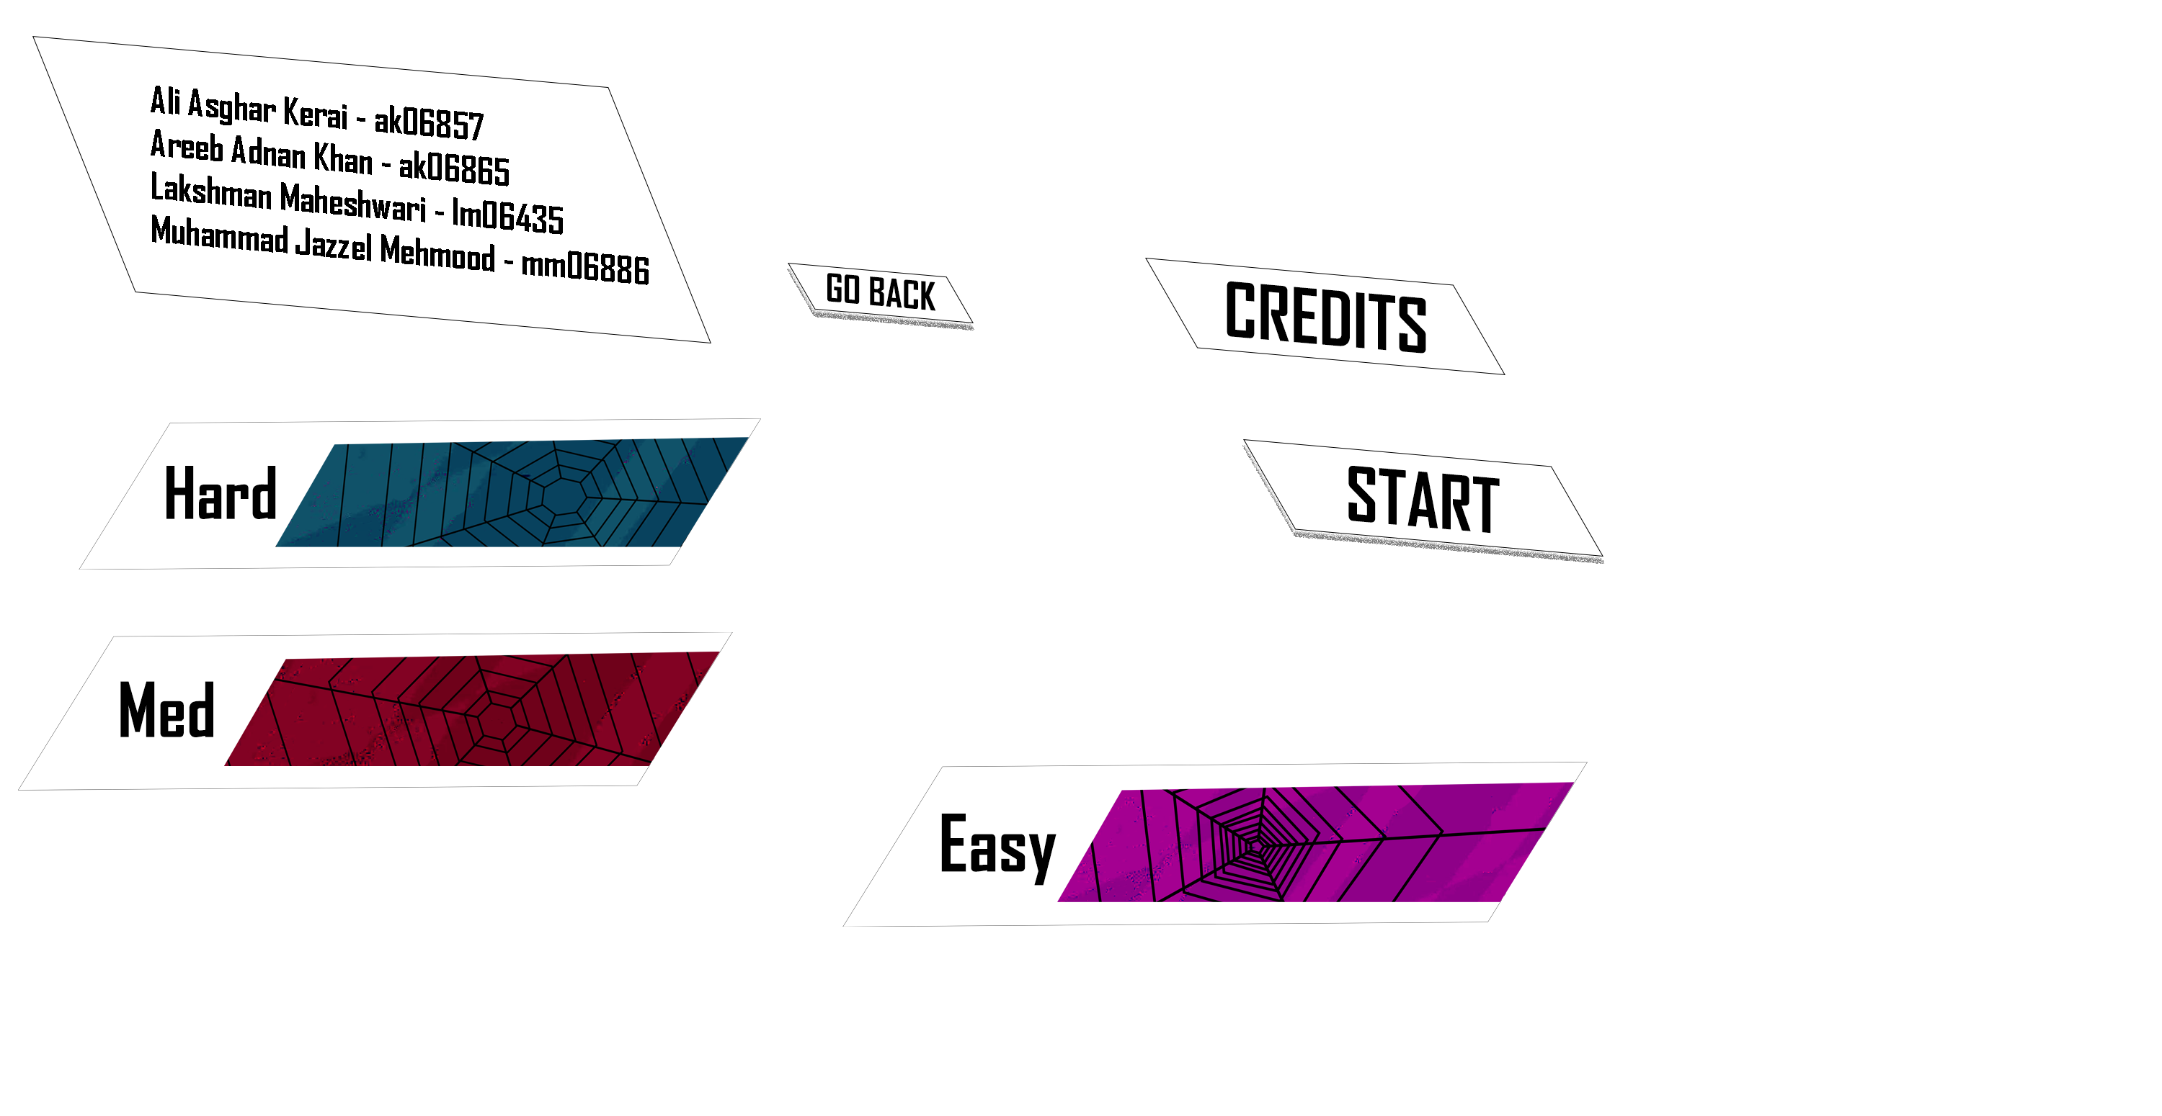

Slide 6
2.Screens
Splash Screen, Level Select &
Credits Screen

Slide 7
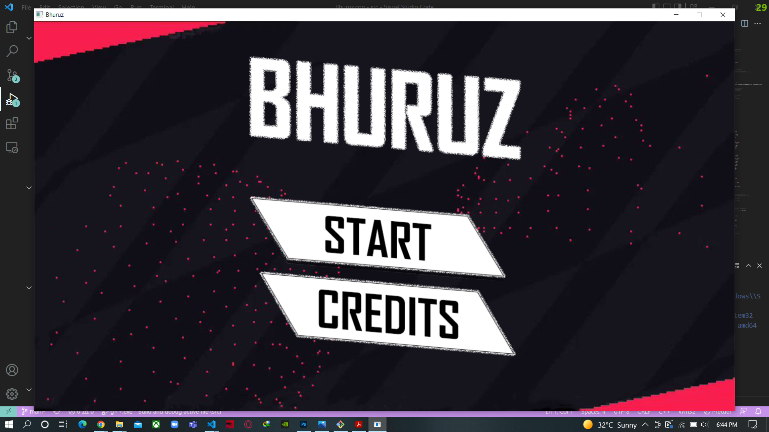
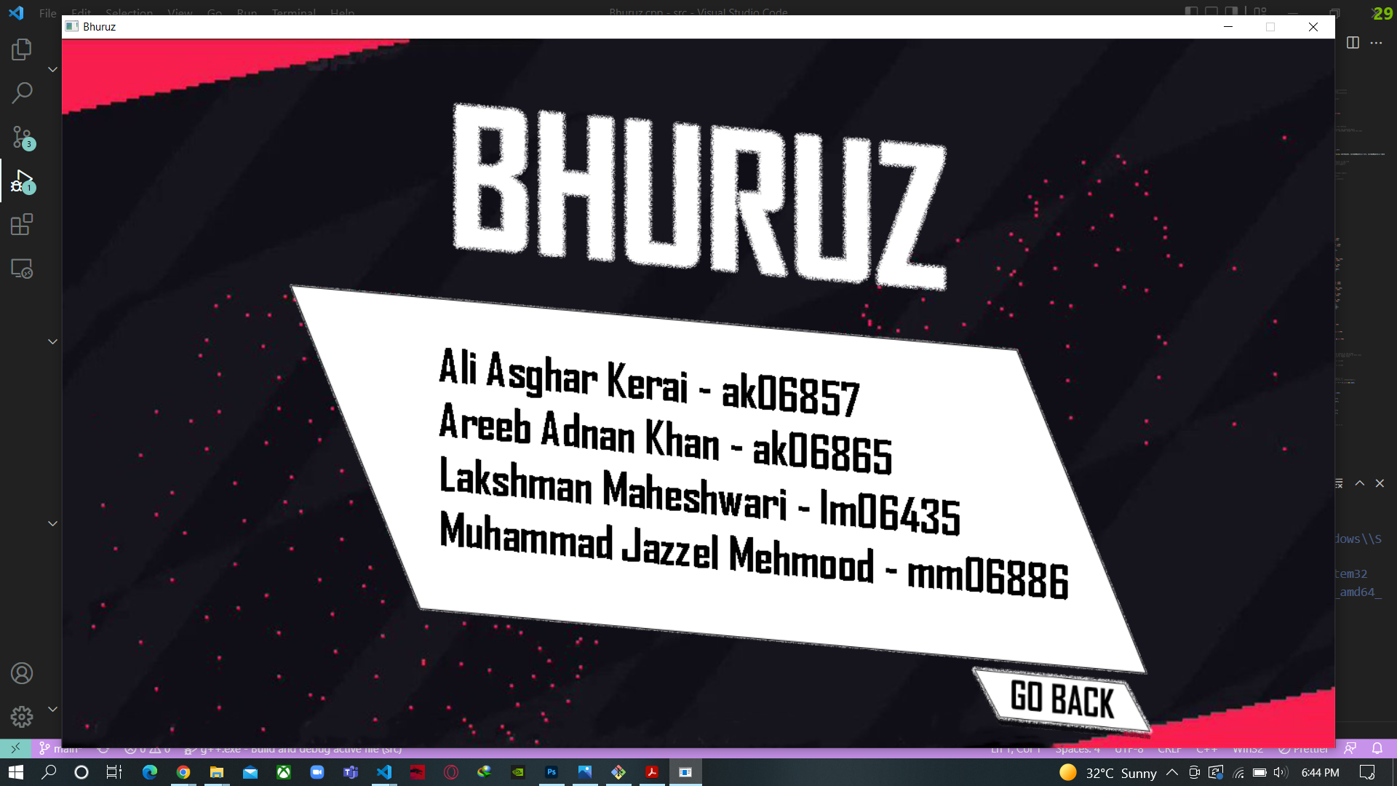
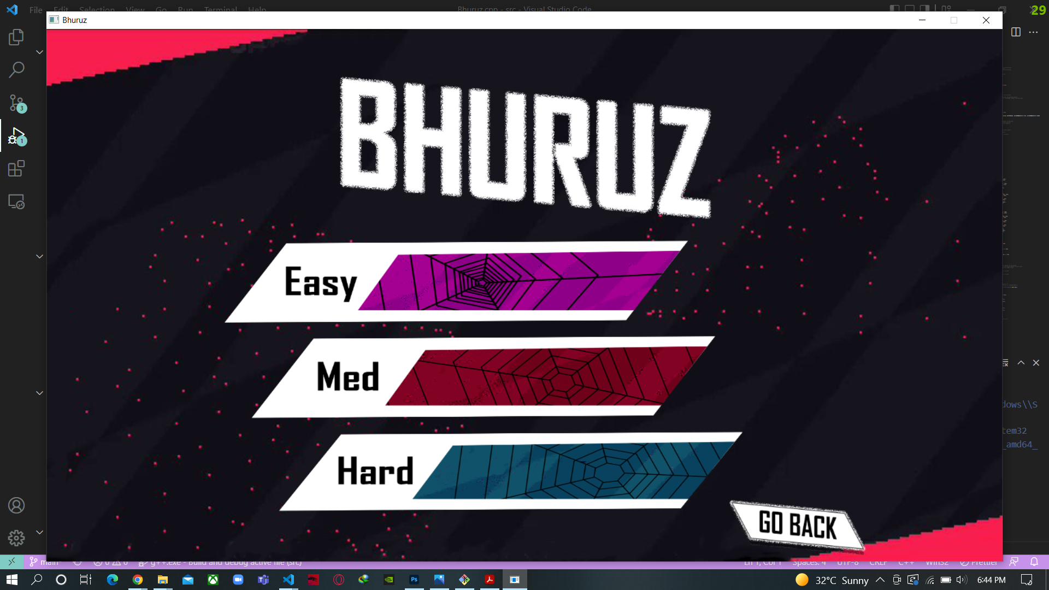

Slide 8
3.Still Testing
Game State, Screen Transitions &
Vehicle Movement ???

Slide 9
4. How - i
GameState ???

Slide 10
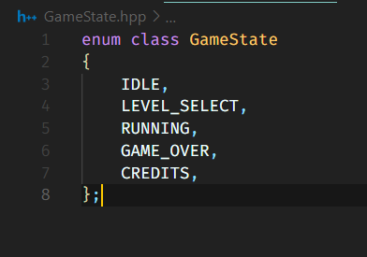
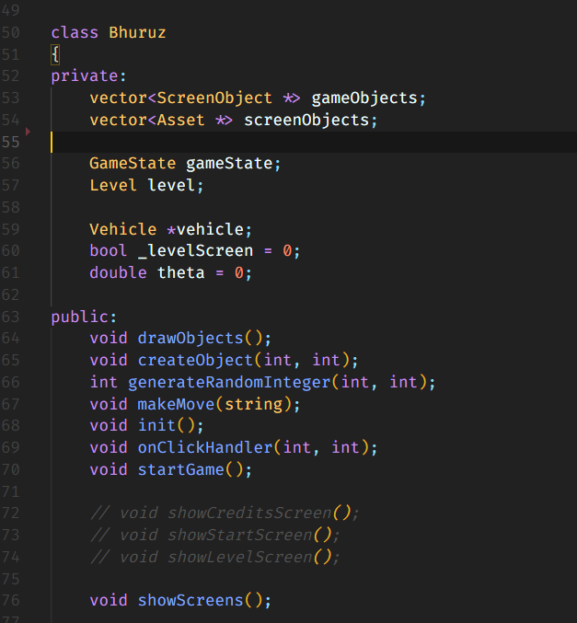

Slide 11
4. How - ii
Screen Transition ???

Slide 12
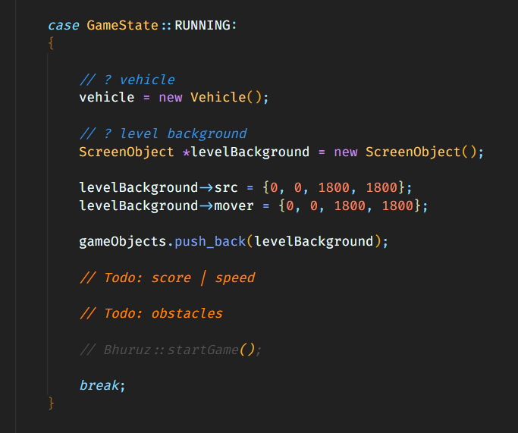
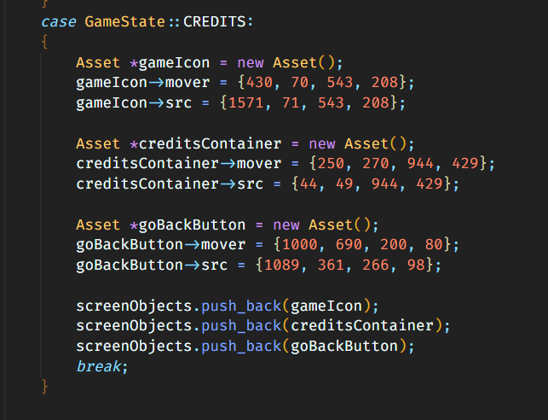
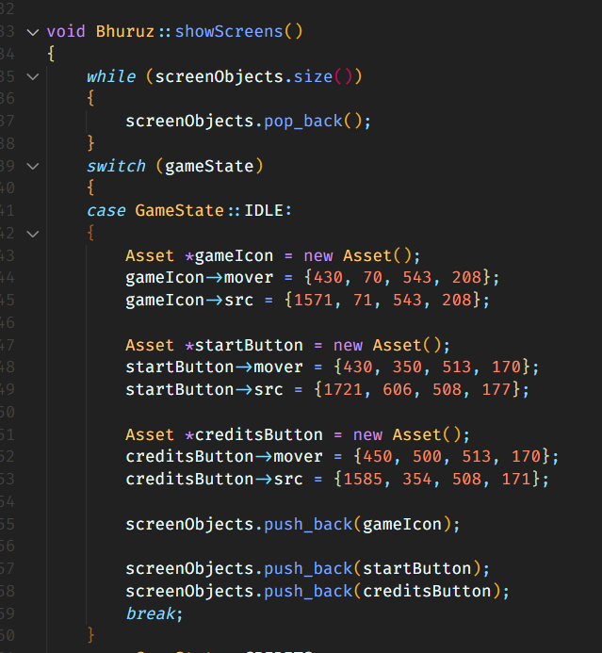
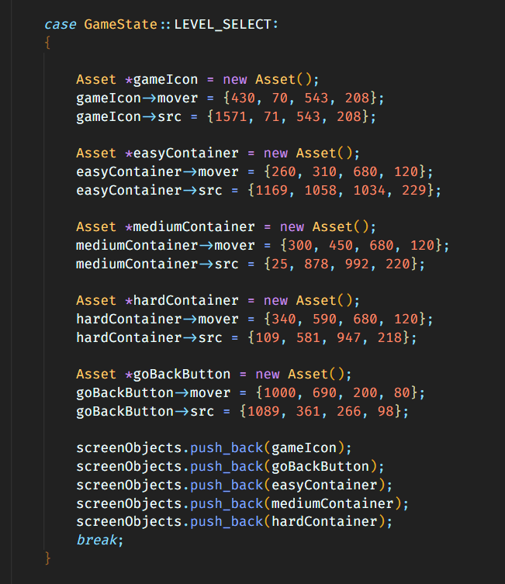
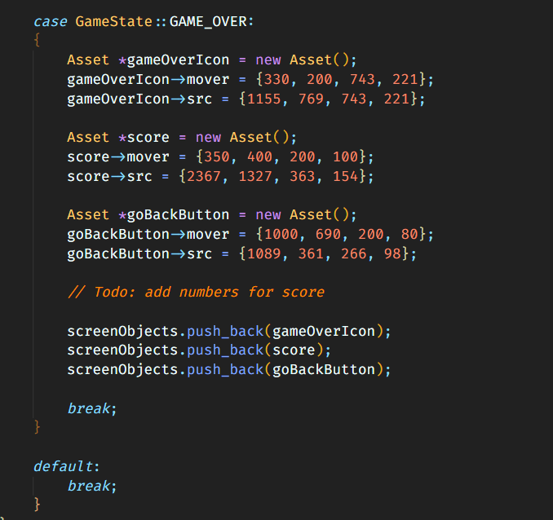

Slide 13
4. How - iii
Vehicle Movement ???

Slide 14
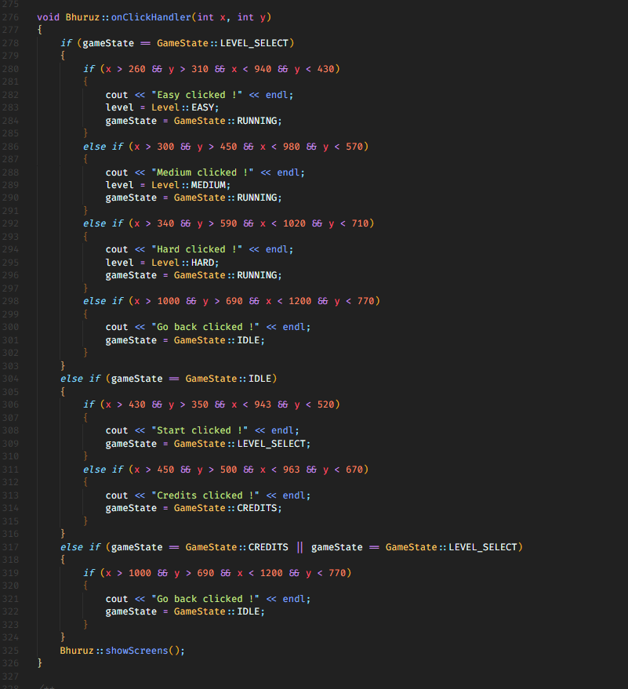
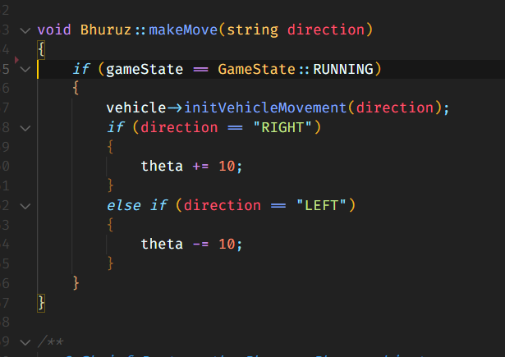

Slide 15
Thanks!
Any questions?
You can email us at
St.habib.edu.pk@ak06857 – Ali Asghar Kerai
St.habib.edu.pk@ak06865 – Areeb Adnan Khan
St.habib.edu.pk@lm06435 – Lakshman Maheshwari
St.habib.edu.pk@mm06886 – Muhammad Jazzel Mehmood

